Slide 1
Conditional Generative Adversarial Network (cGAN) for Image Synthesis
Under the guidance of: Dr Rajendra Nagar
By: Bhavesh Khatri (M23CSE011)
Sireejaa Uppal (M23CSE023)
Ritu Singh (M23CSE017)
Ritobina Ghosh (M23CSA021)

Slide 2
Problem Statement
The project aims to develop a conditional Generative Adversarial Network (cGAN) model that can generate realistic images from input sketches, conditioned on class labels.

Slide 3
Dataset
ISIC Dataset:
HAM10000
10015 images and 1 ground truth response CSV file (containing 1 header row and 10015 corresponding response rows) and paired sketches.
Train: 9014, Test: 1001
7 classes namely: MEL, NV, BCC, AKIEC, BKL, DF, VASC

Slide 4
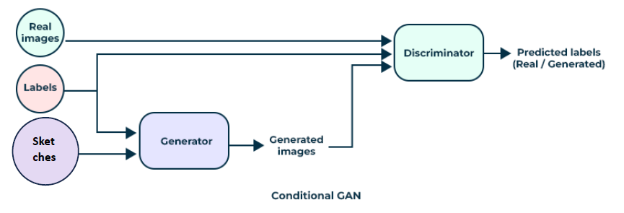

Slide 5
Methodology
cGAN model consists of a generator and discriminator.
Key components include:
Generator takes a sketch and labels to generate images.
Discriminator differentiates between real and generated images.

Slide 6
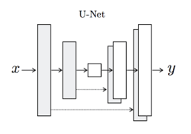
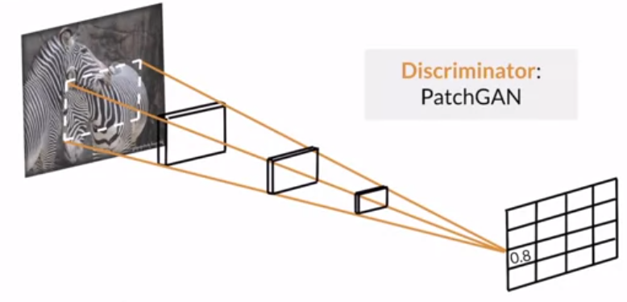
Implementation
Generator:
U-Net architecture, which is a type of convolutional neural network that allows for the use of high-resolution features at the output, which can help to better preserve the detail in the generated images.
PatchGAN architecture, which classifies whether each patch in an image is real or fake, rather than classifying the entire image at once. This can help to better capture the high-frequency detail in images.

Slide 7
Training Process
Training the GAN:
- Generator and discriminator compete with each other.
- Use of BCE for loss calculation and Adam optimizer.
- L1 loss encourages the generator to create fake images that are close to the real images in pixel space.

Slide 8
Result
Loss metrics indicated a balanced training process. The image quality improved significantly over epochs, with final images resembling real photos.

Slide 9
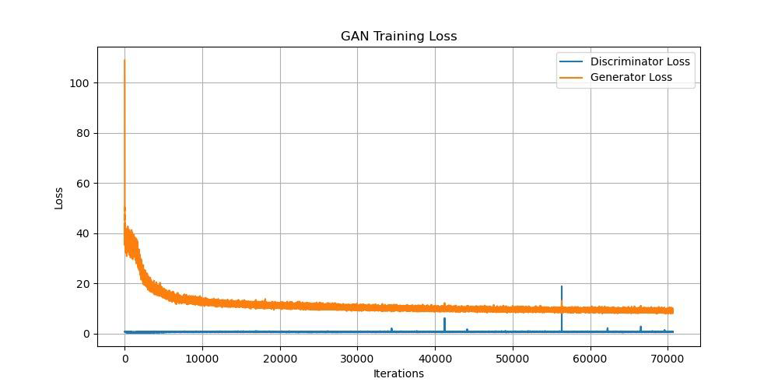
Loss curve

Slide 10
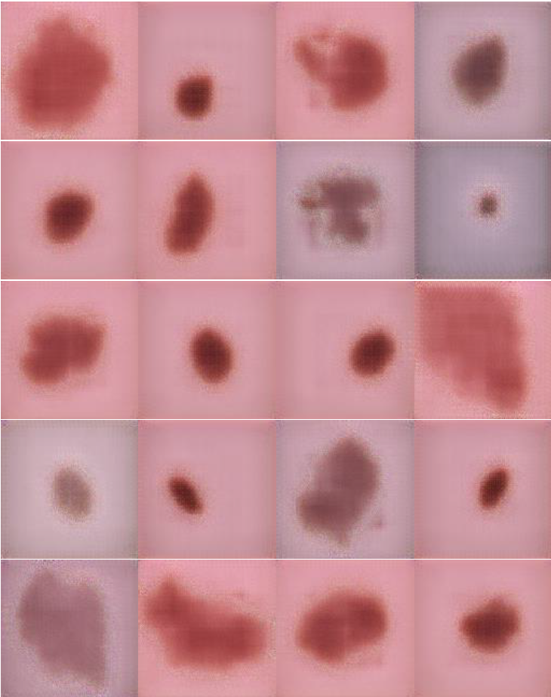
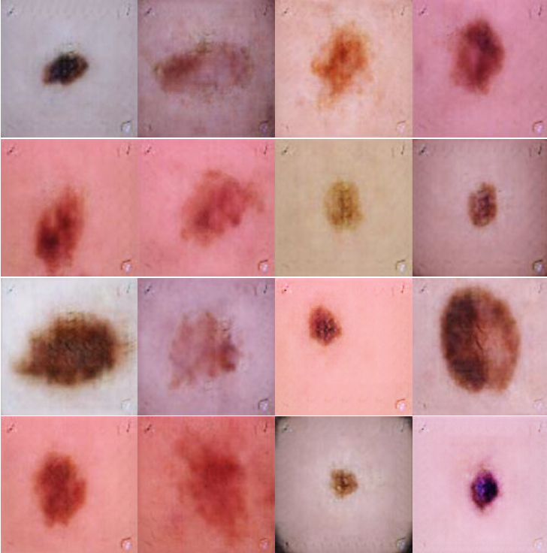
0th Epoch
100th Epoch
Generated Images

Slide 11
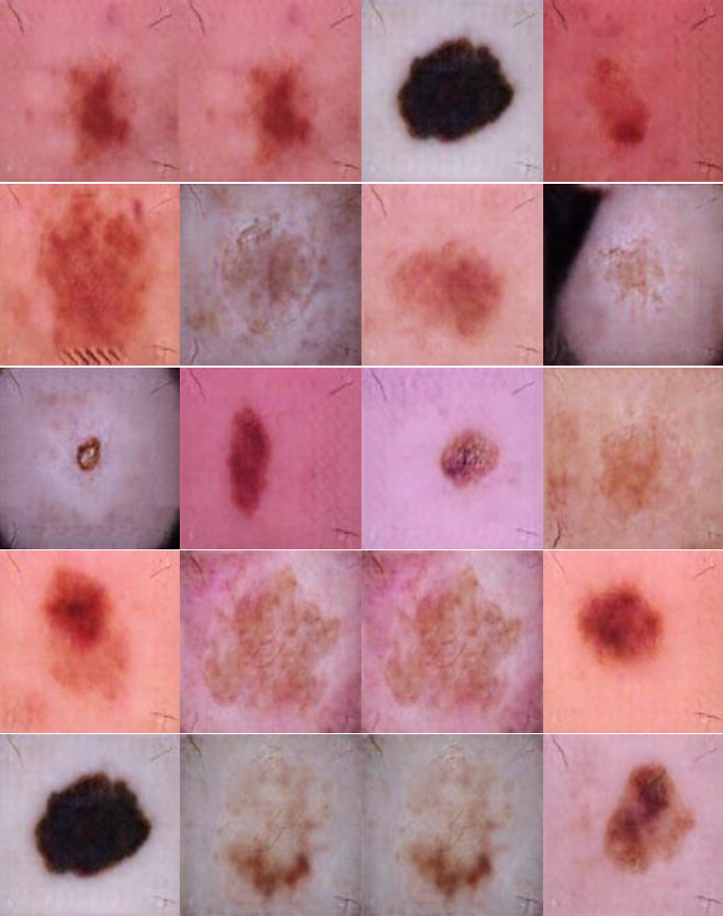
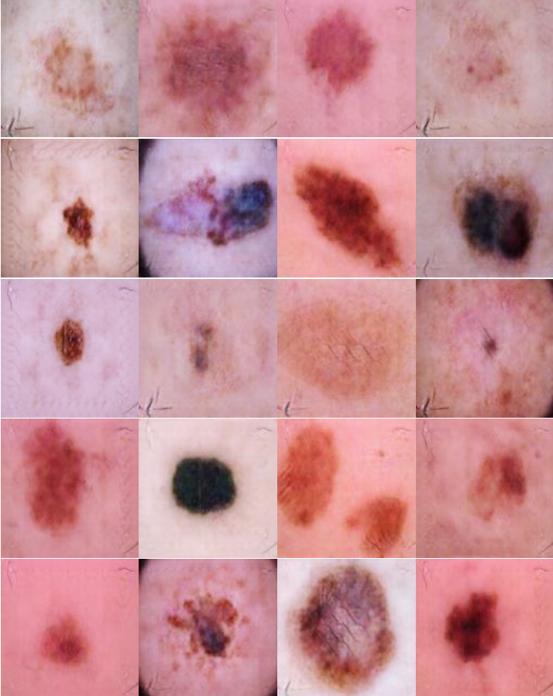
200th Epoch
300th Epoch
Generated Images

Slide 12
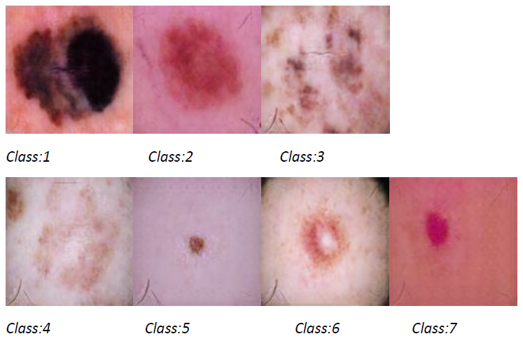
Class-wise generated images

Slide 13
Observations and
Conclusions
cGAN showed potential in generating realistic images. Challenges included maintaining equilibrium and preventing overpowering of discriminator. Future work could explore more complex datasets and architectures.

